Slide 1

Smart Classroom Automation
Department of Computer Science & Engineering – Internet of Things
(Supervisor: Ms. Aditee Mattoo )
Group Members
Name of Member | Roll Number | Role
Hrishitosh Thakur | 2001331550016 | Hardware Modelling & Code Implementation
Shiv Shikhar Sinha | 2001331550033 | Circuit Design & Code (Blynk and IFTTT Configuration)
Ritik Kumar Yadav | 2001331550030 | Hardware Design and Assembly

Slide 2

Index
Introduction
Literature Survey
Problem Statement
Proposed Methodology (Including DFD/ER Diagrams/ Use Cases)
Hardware / Software Requirements
Live Project Progress
Research Paper Status
Future Action Plan

Slide 3
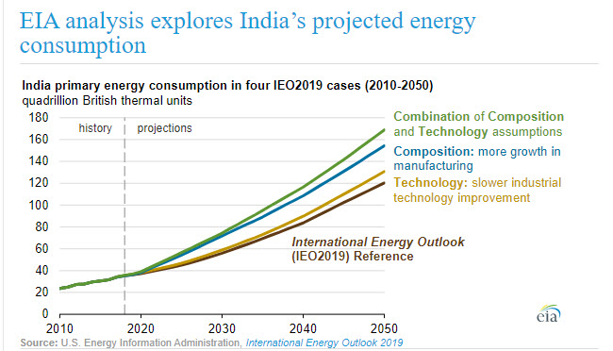
Introduction
In today’s era, energy efficient devices are the need of the time. We humans are wasting too much electricity by not turning of the lights and fans in our class.
People don’t even pay attention to unnecessary usage of electrical energy. So we need a smart system to control the functioning of the lights and fans according to the requirement in the room. The system is based upon IoT.
Ref- US Energy Administration, International Energy Outlook 2019

Slide 4
Literature Survey
1. “Smart Energy Efficient Home Automation System using IOT”, by Satyendra K. Vishwakarma, Prashant Upadhyaya, Babita Kumari, Arun Kumar Mishra.
This paper presents a step-by-step procedure of a smart home automation controller. It uses IOT to convert home appliances to smart and intelligent devices, with the help of design control. An energy efficient system is designed that accesses the smart home remotely using IOT connectivity.

Slide 5
Literature Survey
2. “A Dynamic Distributed Energy Management Algorithm of Home Sensor Network for Home Automation System”, by Tui-Yi Yang, Chu-Sing Yang, Tien-Wen Sung.
This paper proposes an optimization of home power consumption based on PLC (Power Line Communication) for an easy to access home energy consumption. This also proposes a Zigbee, and PLC based renewable energy gateway to monitor the energy generation of renewable energies.

Slide 6
Literature Survey
3. “Enhance Smart Home Automation System based on Internet of Things”, by Tushar Chaurasia and Prashant Kumar Jain.
This paper proposes a system that develops a model to reduce the computation overhead in existing smart home solutions that uses various encryption technologies like AES, ECHD, hybrid, etc. these solutions use intermediate gateway for connecting various sensor devices.

Slide 7
Problem Statement
Design of an independent Smart Classroom Automation System
To formulate the design of an interconnected network of home appliance to be integrated into the Automation System. The objective to account for every appliance and its control to be automated and integrated into the network further formulated into the system.
Wireless control of home appliances (Switch and Voice mode)
To develop the application that would include features of switch and/or voice modes to control the applications.
Monitoring status of appliances
Being able to view the status of home appliances on the application, in order have a better Automation System.

Slide 8
Problem Statement
Secure connection channels between application and Node MCU
Use of secure protocols over Wi-Fi so that other devices are prevented to achieve control over the devices. Secure connections are obtained by SSL over TCP, SSH.
Controlled by any device capable of Wi-Fi (Android, iOS, PC)
To achieve flexibility in control of the appliances, and device capable of Wi-Fi connectivity will be able to obtain a secure control on the Automation System.
Extensible platform for future enhancement
With a strong existing possibility of adding and integrating more features and appliances to the system, the designed system needs to be highly extensible in nature.

Slide 9
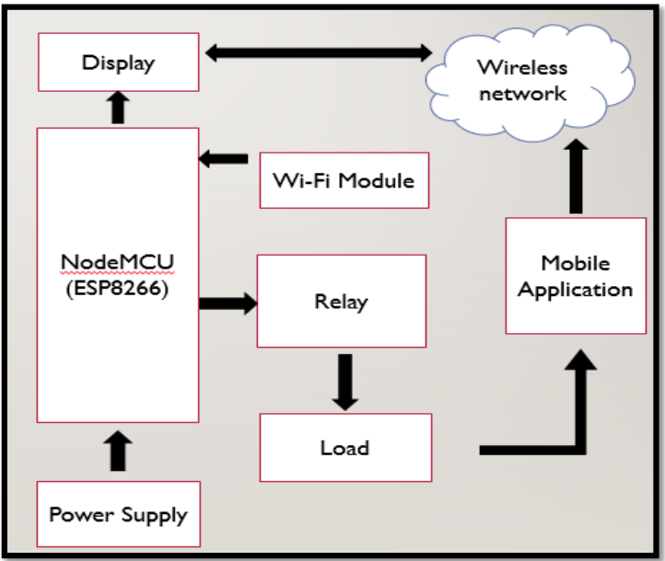
Proposed Methodology
Block Diagram of the Proposed System
The block diagram gives the functionality of the overall project which involves several modules and devices.

Slide 10
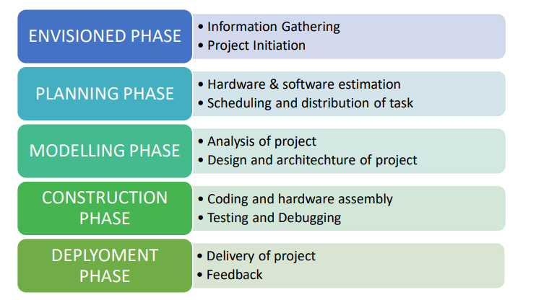
Proposed Methodology

Slide 11
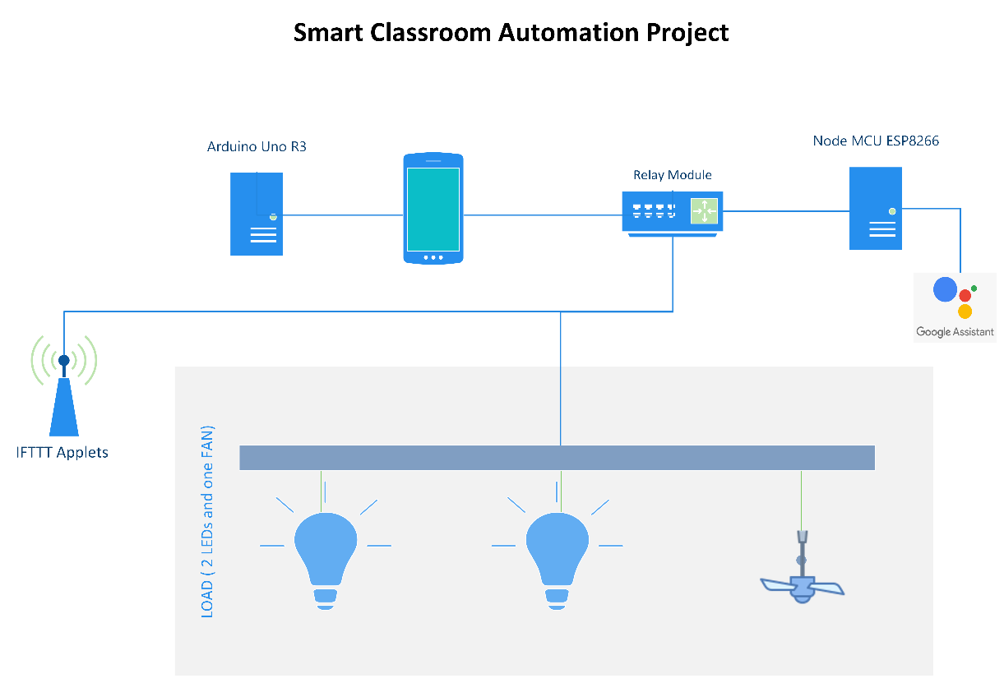
Proposed Methodology
The android OS provides the flexibility of using the open source.
Android Phone acts as a client and data are sent via sockets programming. The application takes command from user in two different modes.
Switch mode: Switch mode uses the radio buttons that are used to control the home appliances. The radio button sends the status of the switch.
Voice mode: Voice Mode is used to control the home appliances using voice command.

Slide 12
Hardware/ Software Requirements
Node MCU is one of the microcontroller unit in the prototype. It has an in-built Wi-Fi module (ESP8266) that establishes wireless remote switching of home appliances.
Four channel relay module consists 4 individual relays physically connected between Node MCU and the home appliances. It takes signals form GPIO pins of Node MCU and accordingly connects or disconnects home appliances from the supply. They act as the switching device.
LED and resistors are used in this prototype to replace real appliances. They indicate power being turned on and off to the appliances. In real time operation they would be replaced by actual home appliances.
Blynk application was designed for the Internet of Things. It can control hardware remotely, it can display sensor data, it can store data, visualize it, etc. the prototype primarily uses Blynk application to sense commands from user to the hardware over wireless network.
Google assistant is a system software present on the android phone. It interprets the voice commands by the user to turn on or off an appliances.
IFTTT application the voice commands interpreted by the google assistant isn’t understandable by Blynk application thus unable to send to the hardware. IFTTT is an intermediate application that interprets commands from Google assistant and sends on and off signal to Blynk application Via Blynk server.

Slide 13
Hardware/ Software Requirements
Arduino UNO R3
Ultrasonic Sensor
Servo Motor
PIR Sensor
Temperature & Humidity Sensor
Gas Sensor
Bread Board
Jumper Wires
USB Cable

Slide 14
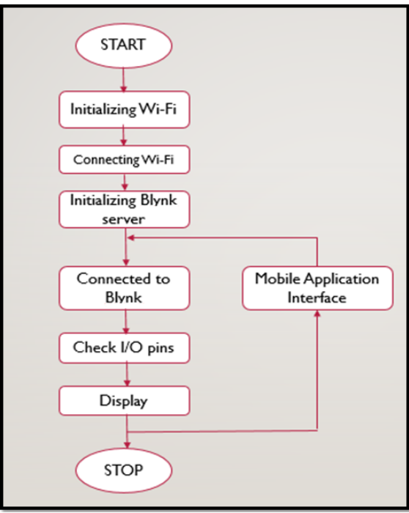
Hardware/ Software Requirements
This flow chart shows the working of the project which is controlled with NodeMCU as the main Microcontroller.
The process starts be initializing the Wi-Fi, the network name and password are written in the code and uploaded to Node MCU.
The android device is connected to Node MCU over Wi-Fi. The Blynk server is set up and connection is made, the devices is identified in the Blynk server using the generated authentication token.
The command for controlling the load is given to the application, and this command, over Wi-Fi network is sent to the Node MCU.

Slide 15
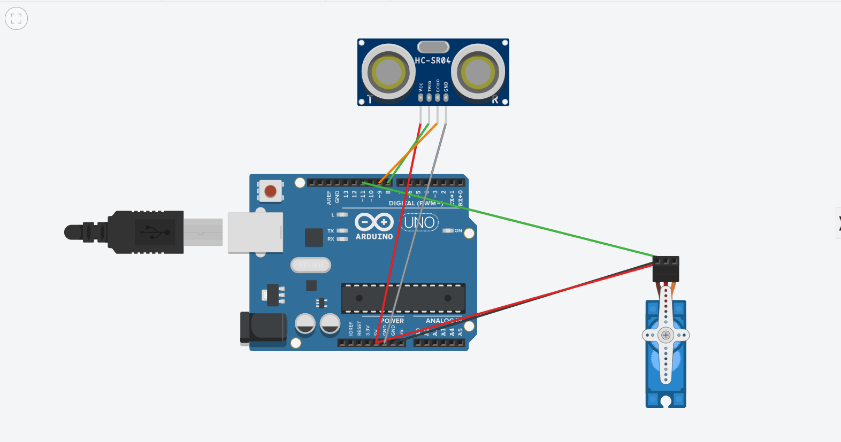
Schematics of Ultrasonic Sensor with Servo Motor (Automatic Door Opening/Closing System)

Slide 16
Schematics of Automated Lights and Fan Control System (Voice Controlled and Blynk App)

Slide 17
Live Project Progress
We can control three buttons which are responsible to operate Fan and LEDs with the help of Buttons on the Blynk App and Voice Controls.
We have used IFTTT (a cloud-server based communication) which create applets as configured by us and performs operations as commanded to.
Also, we can see the Temperature and Humidity with the help of DHT11 Temperature and Humidity Sensor on the Screen in our Blynk App Project.

Slide 18
Research Paper Status
Research Paper Completed | Contents of Research Paper-
Abstract
Keywords,
Introduction,
Literature Survey
Methodology
Hardware Requirements
Software Requirements
Block Diagram
Conclusion and Future Scopes
References.

Slide 19
Future Action Plan
We look forward to develop this prototype into a fully-functional working model and then we will implement this in a physical classroom so that we can experience the usability of Automated Environment.
It will be useful in automating tasks and appliances in a classroom environment.
This project also aims to save energy in the present and future scenarios.

Slide 20
Thank You

Slide 21
Feedback from the Panel
The panel wants the team to :
Make some changes in the presentation and present the prototype model to the panel.

